Slide 1


Title :- Trello
Introduction
Presented By :-
Rohit Singh

Slide 2




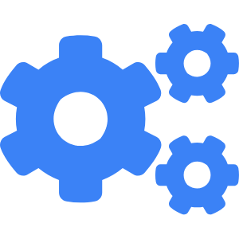
What is Trello?
A Visual Tool for Project Management and Collaboration
Visual Project Boards
Trello provides a visual layout using boards, lists, and cards to manage projects and tasks efficiently.
Intuitive Drag-and-Drop Interface
Tasks can be moved across stages easily, making workflow tracking clear and interactive.
Cloud-Based and Cross-Platform
Trello works on web, desktop, and mobile, ensuring accessibility and synchronization across devices.
Flexible for Any Workflow
From simple to-do lists to complex sprint planning, Trello adapts to personal and team needs.
Notes:
Trello is a user-friendly, web-based project management tool that uses the Kanban methodology. It provides a clean and visual interface where you can manage tasks using boards, lists, and cards — making it easy to plan, organize, and collaborate on projects.
Each board represents a project, lists represent stages or categories, and cards represent individual tasks. With its drag-and-drop interface, Trello allows teams to see their workflow at a glance, making collaboration seamless and intuitive.
Whether you're organizing your personal goals or managing a full agile software development lifecycle, Trello is adaptable, cloud-powered, and mobile-ready, making it a favorite across industries.

Slide 3
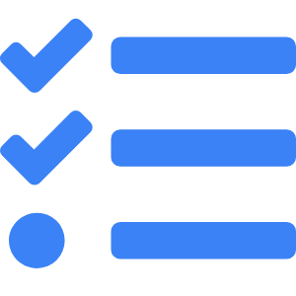

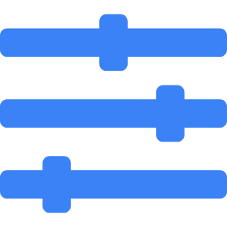

Why Use Trello?
Key Benefits for Software Teams
Streamlined Task Management
Teams can easily plan sprints, assign tasks, and track progress visually.
Improved Collaboration
Real-time updates and comments reduce email clutter and miscommunication.
High Customizability
Labels, checklists, and power-ups enable flexible workflows tailored to development needs.
Transparency & Accountability
Clear task ownership and activity logs increase visibility and team alignment.
Notes:
Trello’s flexible structure and ease of use make it ideal for software teams. Whether you’re following Agile, Scrum, or a custom process, Trello simplifies how you track and manage tasks.
Teams benefit from better organization, visibility, and accountability. Everyone knows who’s working on what and how the project is progressing. With customizable features like labels and checklists, each team can design boards to suit their workflow.
Trello encourages active collaboration. Discussions happen within cards, eliminating email threads and aligning everyone around a shared visual workflow.

Slide 4
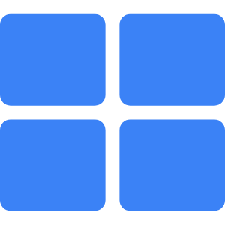
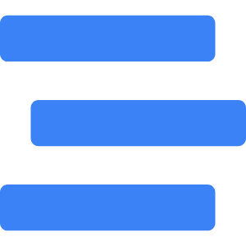
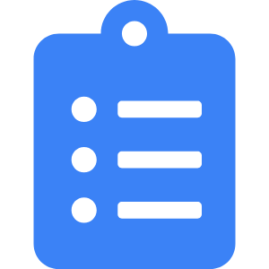
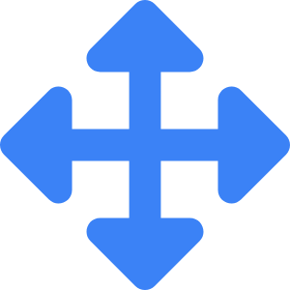
Trello Core Concepts
Boards, Lists, and Cards Explained
Boards = Projects
Each board represents a distinct project or workflow environment.
Lists = Stages
Lists organize cards into stages such as To-Do, Doing, and Done.
Cards = Tasks
Cards hold individual tasks and contain all details, attachments, and conversations.
Drag-and-Drop Simplicity
Users can move cards across lists with ease to reflect task progress.
Notes:
At the heart of Trello are its three core components: Boards, Lists, and Cards.
A **board** serves as your project workspace. For example, you might have a board for a sprint cycle or a feature release. Within each board, you create **lists** to represent workflow stages like 'Backlog', 'In Progress', and 'Completed'.
Inside these lists are **cards**, the atomic units of Trello. Each card is a task with its own comments, attachments, deadlines, and collaborators. The simplicity of dragging cards across lists makes task management both interactive and visually intuitive.

Slide 5


Creating Your First Board
Step-by-Step Guide to Start with Trello
Click 'Create New Board'
Start from the Trello home screen by clicking the board creation button.
Choose a Board Title and Background
Give your board a name and pick a background to personalize it.
Add Lists for Workflow Stages
Add columns like 'To Do', 'In Progress', 'Done' to define your process.
Create Initial Cards
Add tasks using cards and start organizing your work.
Notes:
Getting started with Trello is incredibly simple. From your dashboard, you begin by clicking 'Create new board'. Give it a relevant title, such as 'Website Redesign Sprint', and choose a background that suits your style or team culture.
Next, you'll create lists to define the stages of your workflow. Common ones include 'Backlog', 'To Do', 'Doing', and 'Done', but you can fully customize them.
Now populate your board by adding cards. Each card represents a specific task or issue, which you’ll manage throughout the project. This is the foundation of how Trello visualizes your entire workflow.

Slide 6


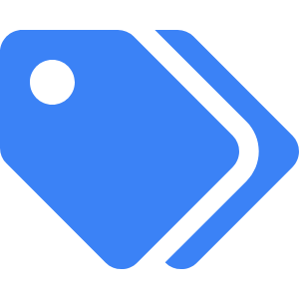

Managing Tasks with Cards
From To-Do to Done
Add Task Cards
Each card represents a task, story, or item in your project workflow.
Assign Members
Assign team members to cards for clear task ownership and accountability.
Use Labels and Due Dates
Color-code tasks and set deadlines to prioritize and schedule effectively.
Move Cards Across Lists
Drag cards from one list to another to reflect task status changes.
Notes:
Cards are the building blocks of Trello task management. You can create a card for every user story, task, or bug in your workflow. These cards serve as detailed containers where you can include descriptions, attach files, leave comments, and tag teammates.
Assigning members to each card ensures accountability. You can also apply labels to categorize work (like 'bug', 'feature', 'urgent') and set due dates for tracking timelines.
As work progresses, simply drag cards across lists — from 'To Do' to 'In Progress' to 'Done'. This visual flow makes progress easy to understand at a glance.

Slide 7

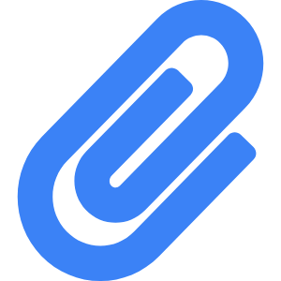


Checklists, Attachments & Labels
Enhancing Task Detail Within Cards
Add Checklists
Break down tasks into smaller steps to track detailed progress.
Attach Files & Links
Include documents, images, or links directly in the card.
Use Labels for Categorization
Color-coded labels help filter and sort tasks across your board.
Comments & Mentions
Use comments to communicate and tag teammates for visibility.
Notes:
Trello cards can do more than hold a task title. Adding **checklists** allows you to split work into detailed sub-tasks with independent progress tracking.
With file **attachments**, you can include design mockups, requirement docs, bug screenshots — whatever is relevant to the task. Labels help you quickly see what type of work is being tracked — for instance, 'High Priority', 'QA', or 'Client Feedback'.
Card comments allow asynchronous collaboration. By tagging team members with `@username`, you can request input, updates, or approvals. Everything stays connected to the work it relates to.

Slide 8
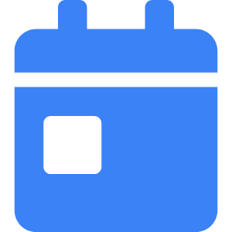

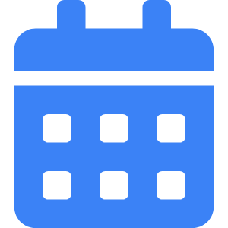

Deadlines, Reminders & Due Dates
Keeping Tasks on Track with Time Management
Set Due Dates on Cards
Every Trello card can have a specific deadline with time.
Enable Reminders
Trello will notify users when tasks are nearing deadlines.
Calendar Power-Up
Visualize deadlines across the board using the calendar view.
Sort and Filter by Date
Use filters to focus on what’s due today, this week, or overdue.
Notes:
Time management in Trello is seamless thanks to built-in due dates and reminders. Every card can have a deadline, which appears visibly on the card and can be updated as needed.
You and your teammates can receive **reminders** as deadlines approach, helping you stay on top of deliverables. With the **Calendar Power-Up**, these dates appear on a full board calendar view, giving a project-wide perspective of your schedule.
To stay focused, Trello allows you to filter and sort tasks by due date — making it easy to prioritize urgent tasks without losing sight of long-term goals.

Slide 9



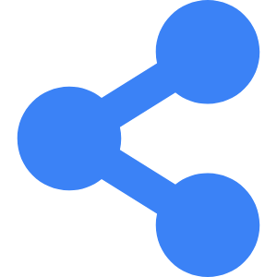
Team Collaboration & Comments
Working Together Within Cards
Comment Threads on Cards
Keep communication contextual and task-specific.
Mention Teammates
Use @username to tag and notify specific users in discussions.
Assign Roles and Members
Designate owners for tasks to ensure accountability.
Share Boards with Teams
Invite users to boards for shared visibility and collaboration.
Notes:
Trello is designed to promote team collaboration without the chaos of endless email chains. Every card includes a **comment thread** where discussions stay tied to the relevant task.
Team members can be tagged using `@mentions`, prompting instant notifications. This keeps communication timely and centralized. You can also assign roles and responsibilities to specific cards so everyone knows who owns what.
Boards can be shared with teammates or across departments, promoting transparency and collaborative problem solving. Whether it’s feedback, approvals, or updates — all communication is centralized inside Trello.

Slide 10
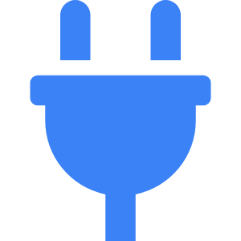



Using Power-Ups
Extend Trello’s Functionality with Integrations
What Are Power-Ups?
Add-ons that extend Trello’s capabilities with external tools.
Popular Power-Ups
Includes Calendar, GitHub, Slack, Google Drive, Jira, and more.
Enable from Power-Up Menu
Search and activate Power-Ups from your board settings.
Custom Automations
Use Butler Power-Up to trigger actions, rules, and buttons.
Notes:
Trello Power-Ups are integrations that let you connect external tools and enhance your boards. Whether you're syncing with GitHub for development, integrating with Google Drive for documentation, or connecting with Slack for team updates — Power-Ups make it possible.
The most popular ones include Calendar, Jira, Confluence, and more. Power-Ups can be activated from each board's settings panel. Most boards allow one free Power-Up, while premium plans enable multiple.
For automation, Trello offers **Butler**, a built-in Power-Up that allows you to create rules, buttons, and scheduled actions. This boosts productivity and standardizes workflow routines.

Slide 11


Sprint Planning with Trello
Agile Workflows for Development Teams
Backlog to Done Structure
Use lists to represent sprint stages from backlog to completion.
Sprint Planning Board
Track stories, bugs, and features with estimation and due dates.
Label for Prioritization
Use colored tags to identify story types and priorities.
Track Progress Visually
Monitor flow of tasks across stages for burndown visibility.
Notes:
Trello is an excellent tool for sprint planning. Agile teams can create a board with lists such as 'Backlog', 'Sprint', 'In Progress', 'QA', and 'Done'. Cards then represent individual stories, bugs, or technical tasks.
You can enrich each card with story points, assignees, and due dates. Using labels to identify high-priority tasks or ticket types enhances clarity. This system mirrors the structure of many popular agile tools but remains flexible and visual.
As you move cards across stages, the team gets a live view of sprint health and progress. This simplicity helps engineers stay organized without being overwhelmed by rigid tooling.

Slide 12



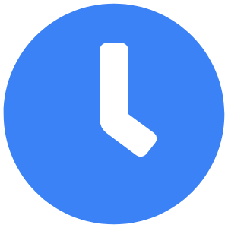
Tracking Progress with Butler Automation
Automate Routine Actions and Boost Productivity
What is Butler?
A Trello automation tool that enables rules, scheduled actions, and buttons.
Rule-Based Triggers
Automate actions when cards are created, moved, or completed.
Buttons and Card Actions
Add custom buttons to cards or boards for repetitive tasks.
Scheduled Reports & Reminders
Automate recurring updates like status summaries or overdue alerts.
Notes:
Trello’s Butler automation tool can save your team significant time by removing the need for manual updates. With Butler, you can set up **triggers** based on card activity, such as moving a card to ‘Done’ automatically adding a checklist or posting a notification.
You can also build **buttons** for common actions like “Mark Ready for Review” that perform multiple steps at once. These are great for workflows that repeat every sprint.
Scheduled automation can send you daily or weekly updates about board progress, overdue tasks, or new assignments. It helps you stay proactive instead of reactive.

Slide 13



Templates and Board Sharing
Streamline Reuse and Team Onboarding
Use Trello Templates
Start faster with pre-built templates for sprints, roadmaps, and more.
Save Your Own Templates
Convert custom boards into templates for repeated use.
Share Boards with Team
Invite members or share links to collaborate in real-time.
Control Access and Roles
Manage permissions for editing, viewing, and commenting.
Notes:
Templates are a powerful way to avoid reinventing the wheel. Trello provides a wide selection of templates for engineering teams, from sprint planning to product roadmaps. You can also convert your own boards into reusable templates for your team.
Sharing a board is simple — just invite users directly or share a public/private link. You can control who can edit, comment, or just view. This flexibility helps scale collaboration across multiple departments.
When onboarding new team members or repeating standard workflows, templates and shared boards greatly reduce setup time and ensure consistency.

